Slide 1
Lesson objective
Whiteboards
Title: Representing events
Aim:
Create and interpret Venn diagrams
Plan:
Daily review
Venn diagrams

Slide 2
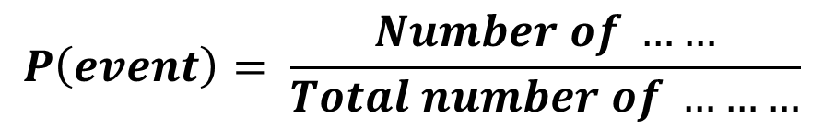
Daily review
Think, pair and share (40 seconds)
What is the difference between theoretical and experimental probability?
What is sample space?
What is the compliment of an event?
$$P\left(event\right)= \frac{Number of ……}{Total number of ………}$$

Slide 3
Terminology
And
Or
In probability “and” describes features that must be satisfied.
E.g. A person who has blue eyes and blonde hair.
Universal set: total number of something being represented
In probability “or” can be inclusive or exclusive.
E.g. A person who has blonde hair or blue eyes. (inclusive of both)
E.g. a person who has blue eyes or blonde hair but not both (Exclusive)

Slide 4
Venn diagram
Draw a mini version into notes
WITH space underneath.
40
U = ________
20 people had blue eyes
27 people had brown hair
12 had both
5 had neither
Blue eyes
Brown hair
Both
8
15
12
5
Notes:
Students to copy Venn diagram when finished and use to create notes

Slide 5
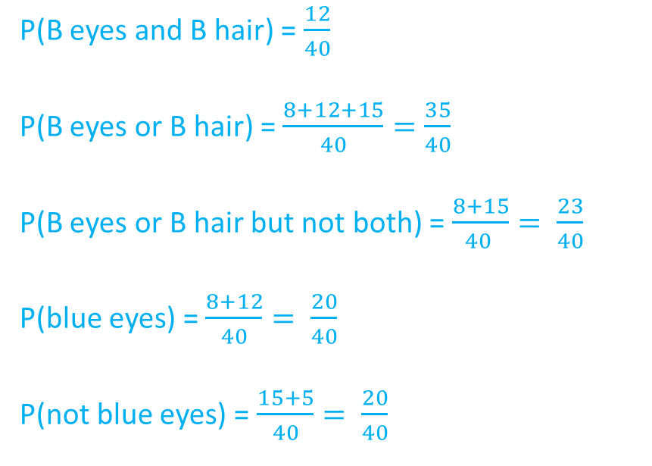
Notes
Universal set = total number represented in diagram
Notation
Example
P(A and B)
P(A or B)
P(A or B not both)
P(A)
P(A’) – complimentary event (the opposite of something)
P(B eyes and B hair) = $\frac{12}{40}$
P(B eyes or B hair) = $\frac{8+12+15}{40}=\frac{35}{40}$
P(B eyes or B hair but not both) = $\frac{8+15}{40 }= \frac{23}{40}$
P(blue eyes) = $\frac{8+12}{40}= \frac{20}{40}$
P(not blue eyes) = $\frac{15+5}{40}= \frac{20}{40}$

Slide 6
Venn Diagrams – An Example
Whiteboards
The Venn diagram below shows two events D and F.
Find: a) P(D and F) b) P(D’) c) P(D and F’)
d) P(D or F) e) P(D’ or F) f) Universal set
D
F
10
6
5
9

Slide 7
Venn Diagrams
Whiteboards
The Venn diagram below shows what some people had for breakfast.
C is the event that they had cereal
O is the event that they had OJ
C
O
19
35
42
Find:
P(C’)
P(C and O’)
P(C’ or O’)
4

Slide 8

Venn Diagrams – Conditional Probability
‘Given that…’ questions in Venn diagrams narrow down the number of possible outcomes to just this part of the Venn diagram
Example:
Given that a person had cereal, what is the probability they didn’t have OJ?
C
OJ
19
35
42
You are only selecting from those who had cereal, so it’s now out of only 54
Of these 54, 19 didn’t have OJ, so the answer is $\frac{19}{54}$
4

Slide 9
Individual practice
Structured Venn diagram questions

